Slide 1
CHARACTERIZATION
The word character derives from the Greek verb charassein, meaning “to mark with a cut.”
Characterization is the method used by an author to develop a character.
When an author introduces the reader to the characters within the work, he or she has two choices: to use direct and indirect characterization.

Slide 2
DIRECT V. INDIRECT CHARACTERIZATION
DIRECT - the author makes direct statements about the character; he or she tells the reader about the character.
Tara is a diligent student who completes all her homework assignments and studies for the tests.
The author tells us that Tara is diligent.
INDIRECT - the author reveals information about a character and his personality through that character's appearance, actions, speech, thoughts and reactions of others to the character; he or she shows the reader about the character. Indirect characterization can be tricky because the reader must analyze the supports closely to determine the character’s personality.
Tara completes all her homework assignments and studies for the tests.
The author shows Tara’s actions (completes all her homework assignments and studies for the tests), so that the reader can conclude that Tara is diligent.

Slide 3
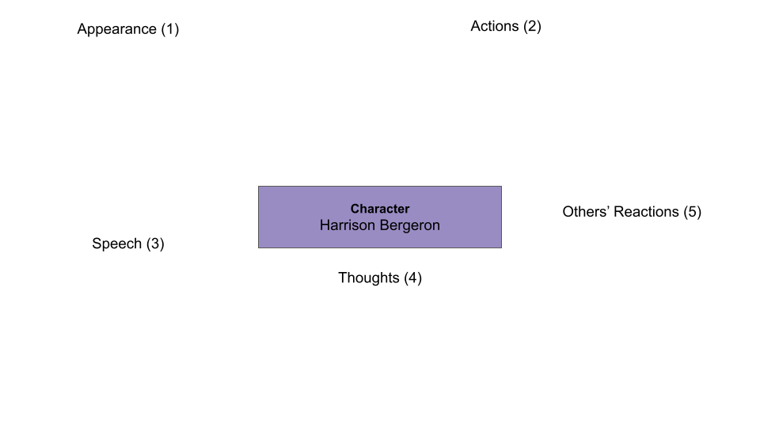
physical description, such as hair and eye color, height, weight, and age
fashion traits, such as conservative trendy, eclectic, or classic
body language, such as folding arms
facial expressions, such as rolling his or her eyes, or smiling frequently
Interaction with his or her environment
Behavioral traits that reveal he or she is shy, confident, socially adept, or introverted
Body and facial language habits
Special talents such as playing music, singing, writing, dancing, or acting
interaction with other characters
family role
the way other characters react to him or her
Living situation: lives alone, or with a family or friends
the types of people the character knows
character's name and/or nickname referenced by other characters
Dialect or style of speech: formal, use of slang, or sarcastic
Words he or she uses to communicate with the other characters
Frequency of speech
Internal thoughts and/or philosophical and religious outlook
Revelations about his or her past and/or a pivotal events
How he or she feels about other characters
Hobbies
Favorite music, food, films, or video games

